Slide 1
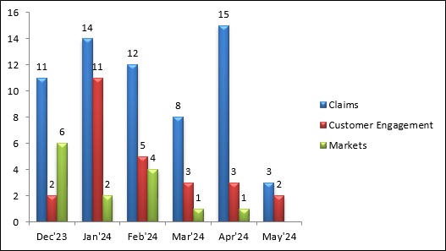
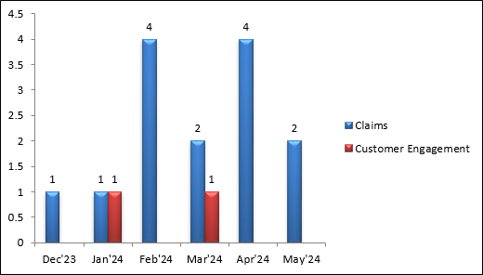
HPI Trend Across Portfolios & Root Cause Summary
Portfolio Level HPI Trend (P1,P2,P3,P4)
Weekly HPI Root Cause Summary
Application | Incident | Priority | Root cause | Sub-Category
Blue Chip Application | INC4091742 | P2 | Infrastructure Monitoring | Server
Blue Chip National Accounts | INC4096593 | P3 | Bad data abend | Input Data File
Blue Chip Claims Front End | INC4116774 | P3 | Database Monitoring | Server
Blue Chip Application | INC4119774 | P3 | Batch job delayed | Input Data
Blue Chip Application | INC4126093 | P3 | Infrastructure Monitoring | Server
Blue Chip Application | INC4136590 | P3 | Connectivity Issue | Server
Multiple Applications | INC4138642 | P3 | Connectivity Issue | Server
P1-P2 Portfolio Level Trends

Slide 2
P2/P3 - Technical Bridges (05/13 - 05/19)
Portfolio, Incident & Application | Issue, Resolution Actions | Impact / Recommendations / Preventive Actions | Root Cause & Subcategory | Action Owners
Claims Blue Chip Application INC4091742– 05/15/2024 | Issue: Blue Chip Application - Unable to Process Claims; Caused by Cotiviti Application Server - Partial Outage Root Cause: Cotiviti Application Server not reachable Resolution: Restarted Cotiviti HCSC Application Server's , issue got resolved. | Impact: User Session got impacted Recommendations: Debrief requested to identify the root cause, scheduled on 05/ | Root Cause: Infrastructure Monitoring Subcategory: Server | Cotiviti - Vendor
Claims Blue Chip National Accounts INC4096593– 05/17/2024 | Issue: Blue Chip National Accounts - Critical Batch Job NAD01BTH Abended - Caused By Bad Records - Proactive Root Cause: Due to multiple bad records. Resolution: Removed all bad records which were starting with the SCCF number 3112023. | Impact: Format Database critical path and Medicare Advantage PPO reports delayed. Recommendations: Team shared the bad records to business and have them submitted to be re-processed following a validation. | Root Cause: Bad data abend Subcategory: Input Data File | Provider/Business

Slide 3
P2/P3 - Technical Bridges (05/20 - 05/26)
Portfolio, Incident & Application | Issue, Resolution Actions | Impact / Recommendations / Preventive Actions | Root Cause & Subcategory | Action Owners
Claims Blue Chip Claims Front End INC4116774– 05/23/2024 | Issue: Blue Chip Claims Front End - Claims gone into suspension queue (MQFP1QM1: RTML.PROD.PREMDB.SUS) - Proactive Root Cause: Yet to be identified Resolution: Reported SCCF were reintroduced and processed as expected by running the batch jobs | Impact: Claims processing got delayed Recommendations: Debrief requested to identify the root cause. | Root Cause: Database Monitoring Subcategory: Server | Business
Claims Blue Chip Application INC4119774– 05/25/2024 | Issue: Multiple Applications - Premier Pricing Down and Errors When Processing Claims; Caused by Large Data Migration - Partial Outage Root Cause: 193,000 NCD records were included as part of data migration which resulted delay in nightly pricing batch cycle completion Resolution: Issue was restored when all the pricing JVMs came up successfully | Impact: Users were unable to process claims in Blue Chip Application Recommendations: Team is investigating to identify why such a large number of records was marked for data migration. | Root Cause: Batch job delayed Subcategory: Input Data | Provider/Business

Slide 4
P2/P3 - Technical Bridges (05/27 - 06/02)
Portfolio, Incident & Application | Issue, Resolution Actions | Impact / Recommendations / Preventive Actions | Root Cause & Subcategory | Action Owners
Claims Blue Chip Application INC4126093– 05/29/2024 | Issue: Blue Chip Application : Multiple Critical Batch Jobs Running Post Holiday Weekend Root Cause: Due to Long weekend batch run Resolution: All Critical paths completed successfully without delay | Impact: No Business impact Recommendations: No Further actions | Root Cause: Infrastructure Monitoring Subcategory: Server | Business
Claims Blue Chip Application INC4136590– 06/01/2024 | Issue: Blue Chip Application- Multiple users received TCH00999 and MQLBMHCK – No Msg from MQ errors in Blue Chip Application Root Cause: HTTP Connectivity errors between HCSC and Avalon vendor which caused users unable to process claims in Blue Chip Application Resolution: Issue was restored when mulesoft team performed restart of esb-prod-claim2 service. | Impact: Users were unable to process claims in Blue Chip Application Recommendations: Team is investigating in the CAT tool on why users unable to path through the error prompt whereas through CAT tool users were able to path through the error prompt | Root Cause: Connectivity Issue Subcategory: Server | Business

Slide 5
P2/P3 - Technical Bridges (05/27 - 06/02)
Portfolio, Incident & Application | Issue, Resolution Actions | Impact / Recommendations / Preventive Actions | Root Cause & Subcategory | Action Owners
Claims COB Solutions INC4138642– 06/02/2024 | Issue: Multiple Applications : COB Solutions, RTIS and Blue Chip Claims Front End were getting connection refused when connecting to ZOSAYS on port 2044 Root Cause: Caused by this CHG0705614. Resolution: Backed out of the CHG0705614 which had restored the issue. | Impact: No Business impact Recommendations: IBM had collected the logs to analyze why new connection profile did not affect as intended. | Root Cause: Connectivity Issue Subcategory: Server | Business

